Slide 1
Welcome back to School!
December Company 2022-2023

Slide 2
Supply List
English/Language Arts ● One 1” binder w/ dividers ● Composition Notebook ● Outsiders by S. E. Hinton | Georgia History ● One spiral-bound notebook ● One 1” binder w/dividers | Team Supplies ● Pouch/box for supplies ● Pencils/pens (lead refills for mechanical pencils) ● Notebook paper for binders ● 1-2 highlighters ● Colored pencils ● Glue sticks ● Sticky notes ● Handheld pencil sharpener ● Cap erasers ● Inexpensive earbuds
 |  | COVID-19 Supplies ● Water bottle (fill at home daily) ● Personal Hand Sanitizer ● Mask
Math ● One 1” binder ● One spiral-bound notebook | Science ● One 1” binder w/dividers ● One spiral-bound notebook | Wish List These aren’t required but help us and be appreciated greatly! ● Band-aids ● Kleenex ● Hand sanitizer ● Clorox wipes ● Colored Paper ● Index cards

Slide 3
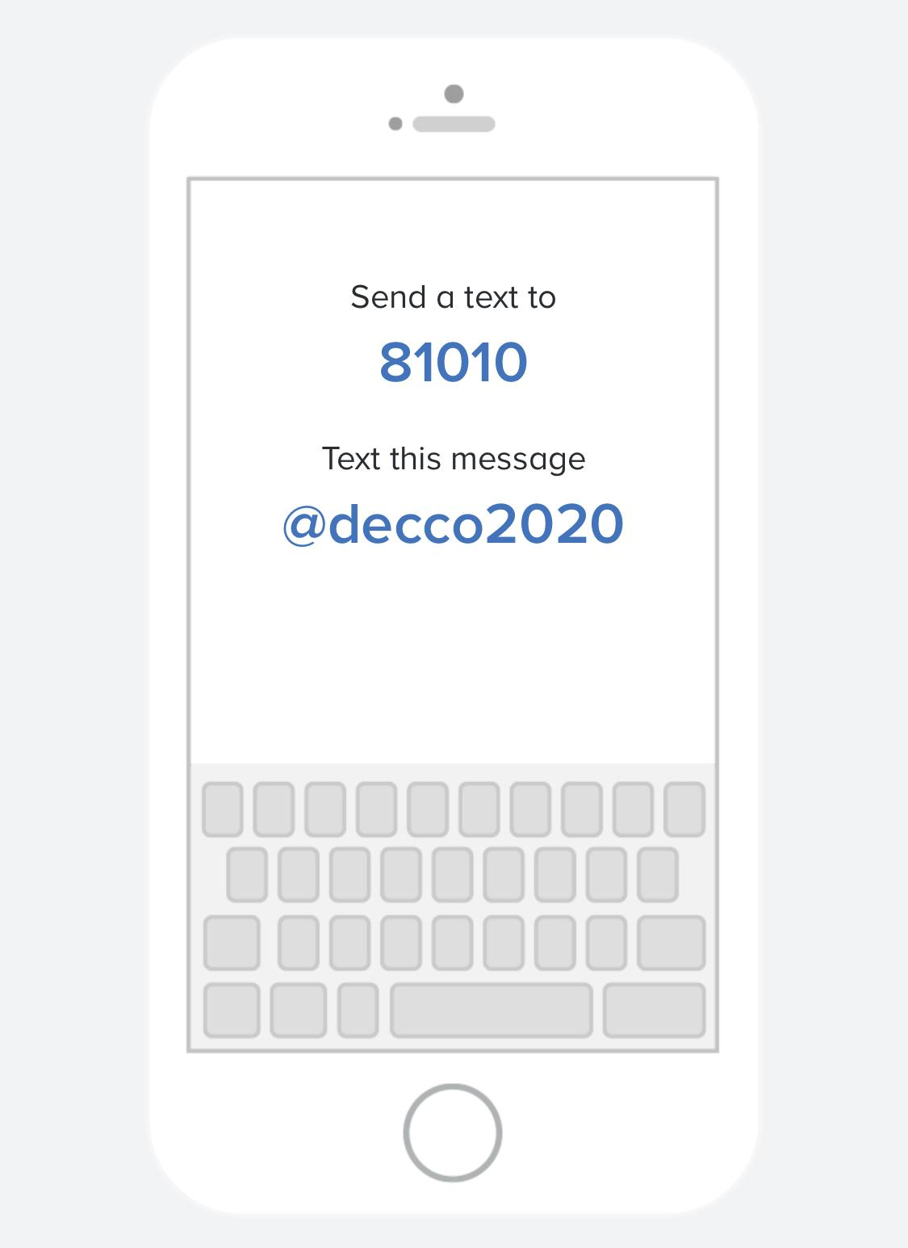
Signing Up For Remind
This will be the same for both Traditional and Remote Students. This is the main way that teachers will communicate with parents, so PLEASE sign up!

Slide 4
Daily Schedule Times subject to change.
Traditional
First Academic 8:00-8:55
Second Academic 9:00-9:55
Third Academic 10:00-10:55
Fourth Academic 11:00-12:00
Lunch 12:00-12:35
Intervention 12:35-1:25
First Exploratory 1:30-2:10
Second Exploratory 2:10-2:50

Slide 5
Grading
This will be the same for all students.
We expect our students to turn in work in a timely fashion, however if the need for make-up or late work arises December Company will use the guidelines provided by TCMS which can be found in the Student Handbook.
Students will be graded based on assignment instructions and, when applicable, rubrics.
We expect your very best while you are with us this school year!
If you ever have any questions about grading, please feel free to email us!

Slide 6
Expectations
Traditional
In the classroom:
I will be quiet during announcements and instructional time.
I will follow classroom rules and procedures for using resources appropriately.
I will respect others and their belongings.
I will arrive on time with the correct materials.
I will complete assigned tasks.
I will take responsibility for making up any missed assignments.
I will get my teachers attention appropriately (raise hand, use signal, etc.).
In the hallway:
I will walk quietly and keep my hands to myself.
I will line up in the designated area for my next class.
I will take the shortest route possible, without stopping, to my destination.

Slide 7
Additional Thoughts for Remote Students
Google Classroom
Each content teacher will have the code for their Google Classroom on their Clever Page.
If you have any issues with joining your Google Classroom, please email that teacher and they can add you to Google Classroom manually.

Slide 8
Need Something? Email us!
Mr. Kaleb Carter, Math - kcarter@tcjackets.net
Ms. Susanne Boykins, ELA - sboykins@tcjackets.net
Mr. Tom Harper, Science - tharper@tcjackets.net
Mr. Brenton Smith, Social Studies - bsmith@tcjackets.net

